Slide 1
Managing Software Projects
Part VI
California State University, cs437, Fall 2007
1

Slide 2
Chapter 21
Project Management Concepts
California State University, cs437, Fall 2007

Slide 3
The 4 P’s
People — the most important element of a successful project
Product — the software to be built.
Process — the set of framework activities and software engineering tasks to get the job done
Project — all work required to make the product a reality.
California State University, cs437, Fall 2007

Slide 4
Stakeholders
Senior managers who define the business issues that often have significant influence on the project.
Project (technical) managers who must plan, motivate, organize, and control the practitioners who do software work.
Practitioners who deliver the technical skills that are necessary to engineer a product or application.
Customers who specify the requirements for the software to be engineered and other stakeholders who have a peripheral interest in the outcome.
End-users who interact with the software once it is released for production use.
California State University, cs437, Fall 2007

Slide 5

Software Teams
How to lead?
How to organize?
How to collaborate?
How to motivate?
How to create good ideas?
California State University, cs437, Fall 2007

Slide 6
Team Leader
The MOI Model
  Motivation. The ability to encourage (by “push or pull”) technical people to produce to their best ability.
  Organization. The ability to mold existing processes (or invent new ones) that will enable the initial concept to be translated into a final product.
  Ideas or innovation. The ability to encourage people to create and feel creative even when they must work within bounds established for a particular software product or application.
California State University, cs437, Fall 2007

Slide 7
Software Teams
The following factors must be considered when selecting a
software project team structure ...
the difficulty of the problem to be solved
the size of the resultant program(s) in lines of code or function points
the time that the team will stay together (team lifetime)
the degree to which the problem can be modularized
the required quality and reliability of the system to be built
the rigidity of the delivery date
the degree of sociability (communication) required for the project
California State University, cs437, Fall 2007

Slide 8
Teams Organizational Paradigms
closed paradigm—structures a team along a traditional hierarchy of authority (example: the chief programmer team).
random paradigm—structures a team loosely and depends on individual initiative of the team members
open paradigm—attempts to structure a team in a manner that achieves some of the controls associated with the closed paradigm but also much of the innovation that occurs when using the random paradigm
synchronous paradigm—relies on the natural compartmentalization of a problem and organizes team members to work on pieces of the problem with little active communication among themselves
suggested by Constantine
California State University, cs437, Fall 2007

Slide 9
Avoid Team “Toxicity”
A frenzied work atmosphere in which team members waste energy and lose focus on the objectives of the work to be performed.
High frustration caused by personal, business, or technological factors that cause friction among team members.
“Fragmented or poorly coordinated procedures” or a poorly defined or improperly chosen process model that becomes a roadblock to accomplishment.
Unclear definition of roles resulting in a lack of accountability and resultant finger-pointing.
“Continuous and repeated exposure to failure” that leads to a loss of confidence and a lowering of morale.
California State University, cs437, Fall 2007

Slide 10
Agile Teams
Team members must have trust in one another.
The distribution of skills must be appropriate to the problem.
Mavericks may have to be excluded from the team, if team cohesiveness is to be maintained.
Team is “self-organizing”
  An adaptive team structure
  Uses elements of Constantine’s random, open, and synchronous paradigms
  Significant autonomy
California State University, cs437, Fall 2007

Slide 11
Coordination & Communication Issues
Reasons why projects get into trouble:
  Large scale of the development efforts.
  Complexity, Confusion, Coordination difficulties.
  Uncertainty leading to a stream of changes.
  Interoperability of many systems.
  New SW must communicate with existing SW to satisfy existing constraints.
  New SW may have interface with existing HW.
California State University, cs437, Fall 2007

Slide 12
Team Coordination & Communication
  Formal, impersonal approaches include software engineering documents and work products (including source code), technical memos, project milestones, schedules, and project control tools, change requests and related documentation, error tracking reports, and repository data.
  Formal, interpersonal procedures focus on quality assurance activities applied to software engineering work products. These include status review meetings and design and code inspections.
  Informal, interpersonal procedures include group meetings for information dissemination and problem solving and “collocation of requirements and development staff.”
  Electronic communication encompasses electronic mail, electronic bulletin boards, and by extension, video-based conferencing systems.
  Interpersonal networking includes informal discussions with team members and those outside the project who may have experience or insight that can assist team members.
California State University, cs437, Fall 2007

Slide 13
The Product Scope
Scope
    Context. How does the software to be built fit into a larger system, product, or business context and what constraints are imposed as a result of the context?
    Information objectives. What customer-visible data objects are produced as output from the software? What data objects are required for input?
    Function and performance. What function does the software perform to transform input data into output? Are any special performance characteristics to be addressed?
Software project scope must be unambiguous and understandable at the management and technical levels.
California State University, cs437, Fall 2007

Slide 14
Problem Decomposition
Sometimes called partitioning or problem elaboration
Once scope is defined …
  It is decomposed into constituent functions
  It is decomposed into user-visible data objects
  or
  It is decomposed into a set of problem classes
Decomposition process continues until all functions or problem classes have been defined and understood.
California State University, cs437, Fall 2007

Slide 15
The Process
Once a process framework has been established
  Consider project characteristics
  Determine the degree of rigor required
  Define a task set for each software engineering activity
    Task set =
      Software engineering tasks
      Work products
      Quality assurance points
      Milestones
California State University, cs437, Fall 2007

Slide 16
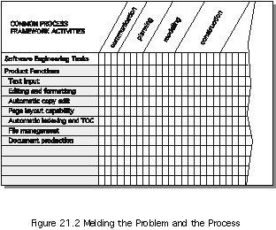
Melding the Problem and the Process
California State University, cs437, Fall 2007

Slide 17
The Project
Projects get into trouble when …
  Software people don’t understand their customer’s needs.
  The product scope is poorly defined.
  Changes are managed poorly.
  The chosen technology changes.
  Business needs change [or are ill-defined].
  Deadlines are unrealistic.
  Users are resistant.
  Sponsorship is lost [or was never properly obtained].
  The project team lacks people with appropriate skills.
  Managers [and practitioners] avoid best practices and lessons learned.
California State University, cs437, Fall 2007

Slide 18
Common-Sense Approach to Projects
Start on the right foot. This is accomplished by working hard (very hard) to understand the problem that is to be solved and then setting realistic objectives and expectations.
Maintain momentum. The project manager must provide incentives to keep turnover of personnel to an absolute minimum, the team should emphasize quality in every task it performs, and senior management should do everything possible to stay out of the team’s way.
Track progress. For a software project, progress is tracked as work products (e.g., models, source code, sets of test cases) are produced and approved (using formal technical reviews) as part of a quality assurance activity.
Make smart decisions. In essence, the decisions of the project manager and the software team should be to “keep it simple.”
Conduct a postmortem analysis. Establish a consistent mechanism for extracting lessons learned for each project.
California State University, cs437, Fall 2007

Slide 19
To Get to the Essence of a Project
Why is the system being developed?
What will be done?
When will it be accomplished?
Who is responsible?
Where are they organizationally located?
How will the job be done technically and managerially?
How much of each resource (e.g., people, software, tools, database) will be needed?
Barry Boehm’s W⁵H²
California State University, cs437, Fall 2007

Slide 20
Critical Practices
Formal risk management
Empirical cost and schedule estimation
Metrics-based project management
Earned value tracking
Defect tracking against quality targets
People aware project management
California State University, cs437, Fall 2007

Slide 21
Chapter 22
Process and Project Metrics
“When you measure what you are speaking about and express it in numbers, you know something about it; but when you cannot measure, when you cannot express it in numbers, your knowledge is of a meager and unsatisfactory kind; it may be the beginning of knowledge, but you have scarcely, in your thoughts, advanced to the stage of a science”.
Lord Kelvin
California State University, cs437, Fall 2007

Slide 22
A Good Manager Measures
process
process metrics
project metrics
measurement
product metrics
product
What do we
use as a
basis?
• size?
• function?
California State University, cs437, Fall 2007

Slide 23
Why Do We Measure?
assess the status of an ongoing project
track potential risks
uncover problem areas before they go “critical,”
adjust work flow or tasks,
evaluate the project team’s ability to control quality of software work products.
California State University, cs437, Fall 2007

Slide 24
Process Measurement
We measure the efficacy of a software process indirectly.
  That is, we derive a set of metrics based on the outcomes that can be derived from the process.
  Outcomes include
    measures of errors uncovered before release of the software
    defects delivered to and reported by end-users
    work products delivered (productivity)
    human effort expended
    calendar time expended
    schedule conformance
    other measures.
We also derive process metrics by measuring the characteristics of specific software engineering tasks.
California State University, cs437, Fall 2007

Slide 25
Process Metrics Guidelines
Use common sense and organizational sensitivity when interpreting metrics data.
Provide regular feedback to the individuals and teams who collect measures and metrics.
Don’t use metrics to appraise individuals.
Work with practitioners and teams to set clear goals and metrics that will be used to achieve them.
Never use metrics to threaten individuals or teams.
Metrics data that indicate a problem area should not be considered “negative.” These data are merely an indicator for process improvement.
Don’t obsess on a single metric to the exclusion of other important metrics.
California State University, cs437, Fall 2007

Slide 26
Software Process Improvement
Process model
SPI
Process improvement
recommendations
Improvement goals
Process metrics
California State University, cs437, Fall 2007

Slide 27
Process Metrics
Quality-related
  focus on quality of work products and deliverables
Productivity-related
  Production of work-products related to effort expended
Statistical SQA data
  error categorization & analysis
Defect removal efficiency
  propagation of errors from process activity to activity
Reuse data
  The number of components produced and their degree of reusability
California State University, cs437, Fall 2007

Slide 28
Project Metrics
used to minimize the development schedule by making the adjustments necessary to avoid delays and mitigate potential problems and risks
used to assess product quality on an ongoing basis and, when necessary, modify the technical approach to improve quality.
every project should measure:
  inputs—measures of the resources (e.g., people, tools) required to do the work.
  outputs—measures of the deliverables or work products created during the software engineering process.
  results—measures that indicate the effectiveness of the deliverables.
California State University, cs437, Fall 2007

Slide 29
Typical Project Metrics
Effort/time per software engineering task
Errors uncovered per review hour
Scheduled vs. actual milestone dates
Changes (number) and their characteristics
Distribution of effort on software engineering tasks
California State University, cs437, Fall 2007

Slide 30
Typical Size-Oriented Metrics
errors per KLOC (thousand lines of code)
defects per KLOC
$ per LOC
pages of documentation per KLOC
errors per person-month
Errors per review hour
LOC per person-month
$ per page of documentation
California State University, cs437, Fall 2007

Slide 31
Typical Function-Oriented Metrics
errors per FP (function point)
defects per FP
$ per FP
pages of documentation per FP
FP per person-month
California State University, cs437, Fall 2007

Slide 32
Why Opt for FP?
Programming language independent
Used readily countable characteristics that are determined early in the software process
Does not “penalize” inventive (short) implementations that use fewer LOC that other more clumsy versions
Makes it easier to measure the impact of reusable components
California State University, cs437, Fall 2007

Slide 33
Comparing LOC and FP
Representative values developed by QSM (Quantitative Software Management)
California State University, cs437, Fall 2007

Slide 34
Object-Oriented Metrics
Number of scenario scripts (use-cases)
Number of support classes (required to implement the system but are not immediately related to the problem domain)
Average number of support classes per key class (analysis class)
Number of subsystems (an aggregation of classes that support a function that is visible to the end-user of a system)
California State University, cs437, Fall 2007

Slide 35
WebE Project Metrics
Number of static Web pages (the end-user has no control over the content displayed on the page)
Number of dynamic Web pages (end-user actions result in customized content displayed on the page)
Number of internal page links (internal page links are pointers that provide a hyperlink to some other Web page within the WebApp)
Number of persistent data objects
Number of external systems interfaced
Number of static content objects
Number of dynamic content objects
Number of executable functions
California State University, cs437, Fall 2007

Slide 36
Measuring Quality
Correctness — the degree to which a program operates according to specification
Maintainability—the degree to which a program is amenable to change
Integrity—the degree to which a program is impervious to outside attack
  Integrity = Σ[1-(threat*(1-security))]
  Ex: threat=25%/50%, security=95%/25%, Integrity=99%/63%
  Threat=prob that an attack will occur;
  Security=Prob. that the attack will be repelled.
Usability—the degree to which a program is easy to use
California State University, cs437, Fall 2007

Slide 37
Defect Removal Efficiency
DRE = E /(E + D)
E is the number of errors found before delivery of the software to the end-user
D is the number of defects found after delivery.
California State University, cs437, Fall 2007

Slide 38
Metrics for Small Organizations
time (hours or days) elapsed from the time a request is made until evaluation is complete, t_{queue}.
effort (person-hours) to perform the evaluation, W_{eval}.
time (hours or days) elapsed from completion of evaluation to assignment of change order to personnel, t_{eval}.
effort (person-hours) required to make the change, W_{change}.
time required (hours or days) to make the change, t_{change}.
errors uncovered during work to make change, E_{change}.
defects uncovered after change is released to the customer base, D_{change}.
California State University, cs437, Fall 2007

Slide 39
Establishing a Metrics Program
The Software Engineering Institute, SEI, has developed a comprehensive
Guidebook for establishing a “goal-driven” software metric program. The
suggested steps are:
Identify your business goals.
Identify what you want to know or learn.
Identify your subgoals.
Identify the entities and attributes related to your subgoals.
Formalize your measurement goals.
Identify quantifiable questions and the related indicators that you will use to help you achieve your measurement goals.
Identify the data elements that you will collect to construct the indicators that help answer your questions.
Define the measures to be used, and make these definitions operational.
Identify the actions that you will take to implement the measures.
Prepare a plan for implementing the measures.
California State University, cs437, Fall 2007

Slide 40
Chapter 23
Estimation for Software Projects
California State University, cs437, Fall 2007

Slide 41
Software Project Planning
The overall goal of project planning is to establish a pragmatic strategy for controlling, tracking, and monitoring a complex technical project.
Why?
So the end result gets done on time, with quality and within budget!
California State University, cs437, Fall 2007

Slide 42
Project Planning Task Set-I
Establish project scope
Determine feasibility
Analyze risks
  Risk analysis is considered in detail in Chapter 25.
Define required resources
  Determine require human resources
  Define reusable software resources
  Identify environmental resources
California State University, cs437, Fall 2007

Slide 43
Project Planning Task Set-II
Estimate cost and effort
  Decompose the problem
  Develop two or more estimates using size, function points, process tasks or use-cases
  Reconcile the estimates
Develop a project schedule
  Scheduling is considered in detail in Chapter 24.
    Establish a meaningful task set
    Define a task network
    Use scheduling tools to develop a timeline chart
    Define schedule tracking mechanisms
California State University, cs437, Fall 2007

Slide 44
Estimation
Estimation of resources, cost, and schedule for a software engineering effort requires
  experience
  access to good historical information (metrics).
  the courage to commit to quantitative predictions when qualitative information is all that exists.
Estimation carries inherent risk and this risk leads to uncertainty
California State University, cs437, Fall 2007

Slide 45
Write it Down!
Project Scope
Estimates
Risks
Schedule
Control strategy
Software
Project
Plan
California State University, cs437, Fall 2007

Slide 46
To Understand Scope ...
Understand the customers needs
understand the business context
understand the project boundaries
understand the customer’s motivation
understand the likely paths for change
understand that ...
Even when you understand,
nothing is guaranteed!
California State University, cs437, Fall 2007

Slide 47
What is Scope?
Software scope describes
  the functions and features that are to be delivered to end-users
  the data that are input and output
  the “content” that is presented to users as a consequence of using the software
  the performance, constraints, interfaces, and reliability that bound the system.
Scope is defined using one of two techniques:
    A narrative description of software scope is developed after communication with all stakeholders.
    A set of use-cases is developed by end-users.
California State University, cs437, Fall 2007

Slide 48
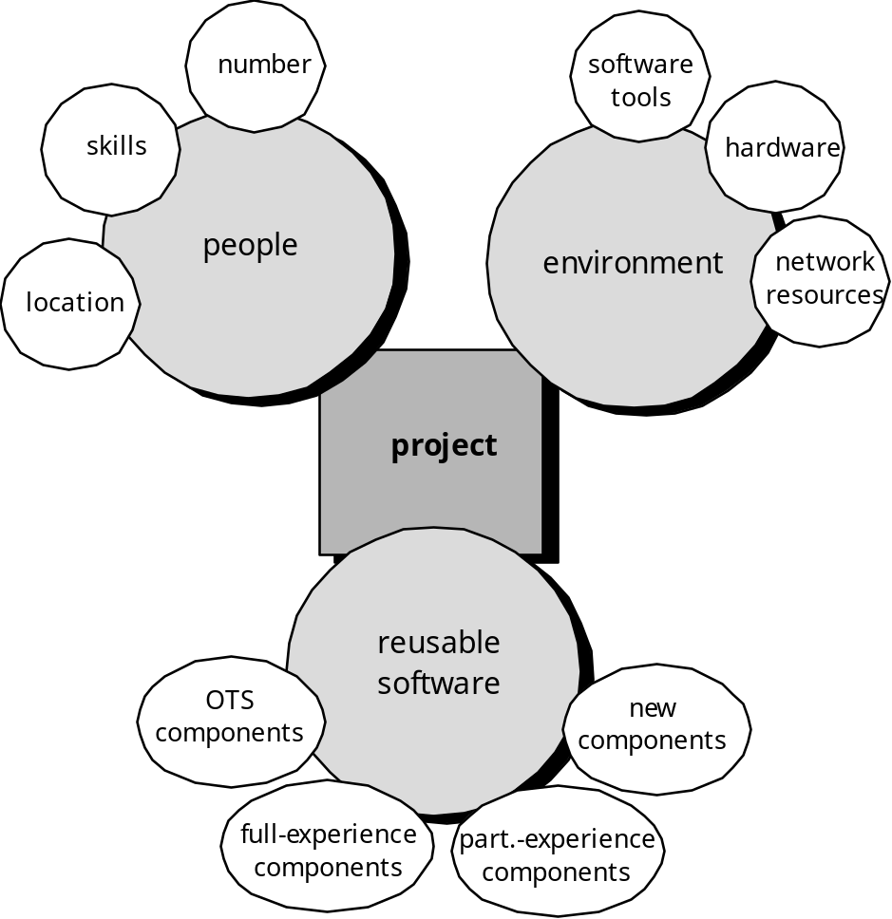
Resources
California State University, cs437, Fall 2007

Slide 49

Project Estimation
Project scope must be understood
Elaboration (decomposition) is necessary
Historical metrics are very helpful
At least two different techniques should be used
Uncertainty is inherent in the process
California State University, cs437, Fall 2007

Slide 50

Estimation Techniques
Past (similar) project experience
Conventional estimation techniques
  task breakdown and effort estimates
  size (e.g., FP) estimates
Empirical models
Automated tools
California State University, cs437, Fall 2007

Slide 51
Estimation Accuracy
Predicated on …
  the degree to which the planner has properly estimated the size of the product to be built
  the ability to translate the size estimate into human effort, calendar time, and dollars (a function of the availability of reliable software metrics from past projects)
  the degree to which the project plan reflects the abilities of the software team
  the stability of product requirements and the environment that supports the software engineering effort.
California State University, cs437, Fall 2007

Slide 52
Functional Decomposition
Statement
of
Scope
functional
decomposition
Perform a Grammatical “parse”
California State University, cs437, Fall 2007

Slide 53
Conventional Methods:
LOC/FP Approach
compute LOC/FP using estimates of information domain values
use historical data to build estimates for the project
California State University, cs437, Fall 2007

Slide 54
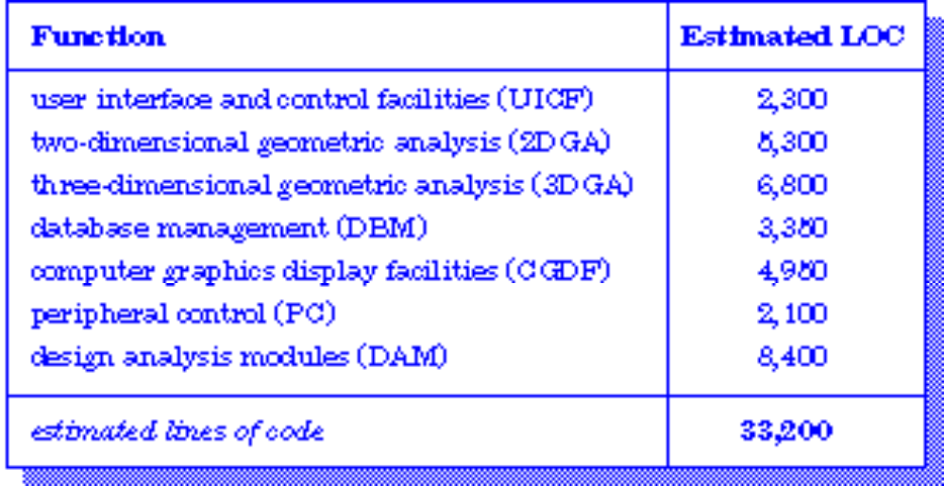
Example: LOC Approach
Average productivity for systems of this type = 620 LOC/pm.
Burdened labor rate =$8000 per month, the cost per line of code is approximately $13.
Based on the LOC estimate and the historical productivity data, the total estimated project cost is $431,000 and the estimated effort is 54 person-months.
California State University, cs437, Fall 2007

Slide 55
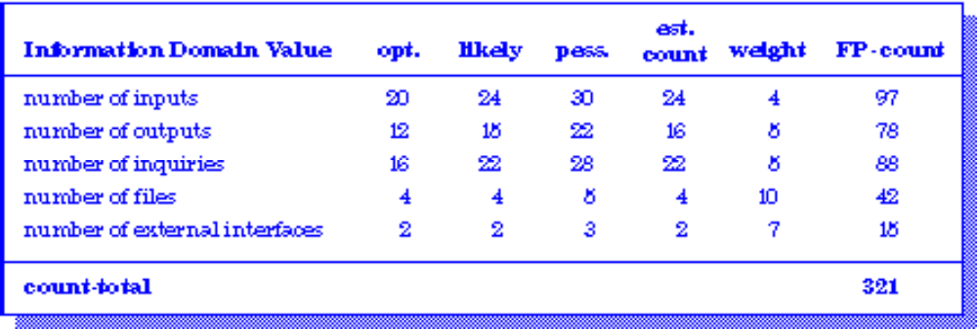
Example: FP Approach
The estimated number of FP is derived:
FP_{estimated} = count-total 3 [0.65 + 0.01 3 S (F_{i})]
FP_{estimated} = 375
organizational average productivity = 6.5 FP/pm.
burdened labor rate = $8000 per month, the cost per FP is approximately $1230.
Based on the FP estimate and the historical productivity data, the total estimated project cost is $461,000 and the estimated effort is 58 person-months.
California State University, cs437, Fall 2007

Slide 56
Process-Based Estimation
Obtained from “process framework”
framework activities
application
functions
Effort required to accomplish
each framework activity for each application function
California State University, cs437, Fall 2007

Slide 57
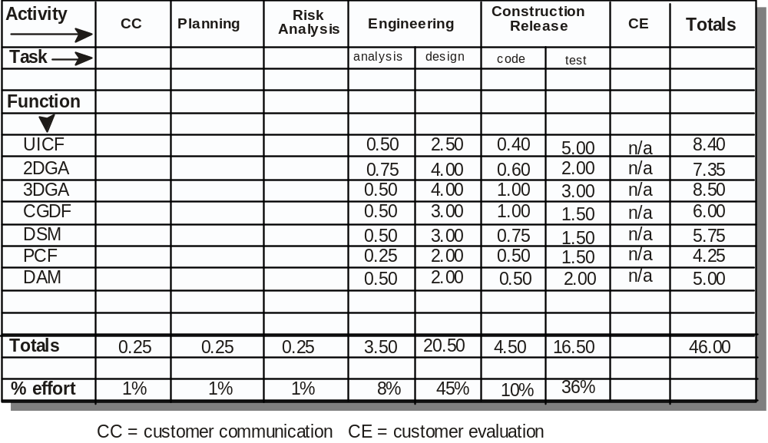
Process-Based Estimation Example
cc=customer communication CE= customer evaluation
Based on an average burdened labor rate of $8,000 per month, the total estimated project cost is $368,000 and the estimated effort is 46 person-months.
California State University, cs437, Fall 2007

Slide 58

Tool-Based Estimation
project characteristics
calibration factors
LOC/FP data
California State University, cs437, Fall 2007

Slide 59
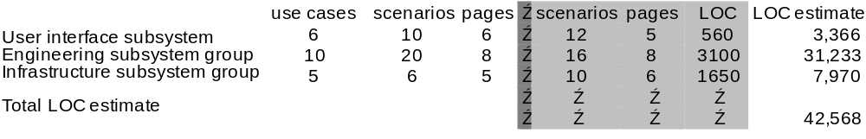
Estimation with Use-Cases
Using 620 LOC/pm as the average productivity for systems of this type and a burdened labor rate of $8000 per month, the cost per line of code is approximately $13. Based on the use-case estimate and the historical productivity data, the total estimated project cost is $552,000 and the estimated effort is 68 person-months.
California State University, cs437, Fall 2007

Slide 60
Empirical Estimation Models
General form:
exponent
effort = tuning coefficient * size
usually derived
empirically
as person-months
derived
of effort required
usually LOC but
may also be
either a constant or
function point
a number derived based
on complexity of project
California State University, cs437, Fall 2007

Slide 61
COCOMO-II
COCOMO II is actually a hierarchy of estimation models that address the following areas:
    Application composition model. Used during the early stages of software engineering, when prototyping of user interfaces, consideration of software and system interaction, assessment of performance, and evaluation of technology maturity are paramount.
    Early design stage model. Used once requirements have been stabilized and basic software architecture has been established.
    Post-architecture-stage model. Used during the construction of the software.
California State University, cs437, Fall 2007

Slide 62
The Software Equation
A dynamic multivariable model
E = [LOC x B^{0.333}/P]³ x (1/t⁴)
where
E = effort in person-months or person-years
t = project duration in months or years
B = “special skills factor”
P = “productivity parameter”
California State University, cs437, Fall 2007

Slide 63
Estimation for OO Projects-I
Develop estimates using effort decomposition, FP analysis, and any other method that is applicable for conventional applications.
Using object-oriented analysis modeling (Chapter 8), develop use-cases and determine a count.
From the analysis model, determine the number of key classes (called analysis classes in Chapter 8).
Categorize the type of interface for the application and develop a multiplier for support classes:
  Interface type Multiplier
  No GUI 2.0
  Text-based user interface 2.25
  GUI 2.5
  Complex GUI 3.0
California State University, cs437, Fall 2007

Slide 64
Estimation for OO Projects-II
Multiply the number of key classes (step 3) by the multiplier to obtain an estimate for the number of support classes.
Multiply the total number of classes (key + support) by the average number of work-units per class. Lorenz and Kidd suggest 15 to 20 person-days per class.
Cross check the class-based estimate by multiplying the average number of work-units per use-case
California State University, cs437, Fall 2007

Slide 65
Estimation for Agile Projects
Each user scenario (a mini-use-case) is considered separately for estimation purposes.
The scenario is decomposed into the set of software engineering tasks that will be required to develop it.
Each task is estimated separately. Note: estimation can be based on historical data, an empirical model, or “experience.”
  Alternatively, the ‘volume’ of the scenario can be estimated in LOC, FP or some other volume-oriented measure (e.g., use-case count).
Estimates for each task are summed to create an estimate for the scenario.
  Alternatively, the volume estimate for the scenario is translated into effort using historical data.
The effort estimates for all scenarios that are to be implemented for a given software increment are summed to develop the effort estimate for the increment.
California State University, cs437, Fall 2007

Slide 66
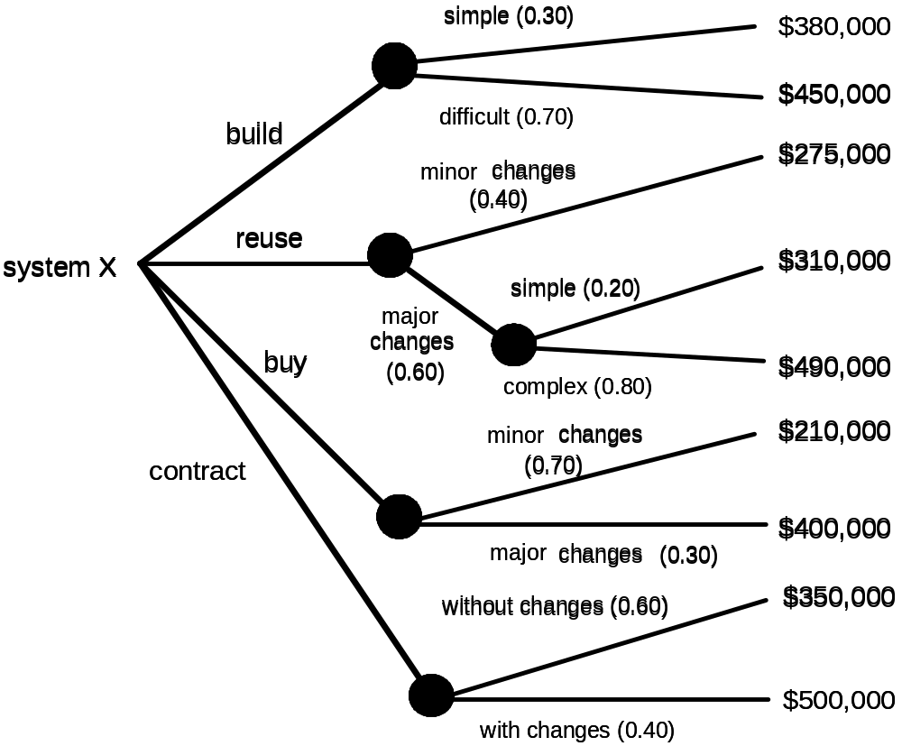
The Make-Buy Decision
California State University, cs437, Fall 2007

Slide 67
Computing Expected Cost
expected cost =
(path probability) x (estimated path cost)
i
i
For example, the expected cost to build is:
expected cost = 0.30 ($380K) + 0.70 ($450K)
build
= $429 K
similarly,
expected cost = $382K
reuse
expected cost = $267K
buy
expected cost = $410K
contr
California State University, cs437, Fall 2007

Slide 68
Chapter 24
Project Scheduling and Tracking
California State University, cs437, Fall 2007

Slide 69
Why Are Projects Late?
an unrealistic deadline established by someone outside the software development group
changing customer requirements that are not reflected in schedule changes;
an honest underestimate of the amount of effort and/or the number of resources that will be required to do the job;
predictable and/or unpredictable risks that were not considered when the project commenced;
technical difficulties that could not have been foreseen in advance;
human difficulties that could not have been foreseen in advance;
miscommunication among project staff that results in delays;
a failure by project management to recognize that the project is falling behind schedule and a lack of action to correct the problem
California State University, cs437, Fall 2007

Slide 70
Scheduling Principles
compartmentalization—define distinct tasks
interdependency—indicate task interrelationship
effort validation—be sure resources are available
defined responsibilities—people must be assigned
defined outcomes—each task must have an output
defined milestones—review for quality
California State University, cs437, Fall 2007

Slide 71
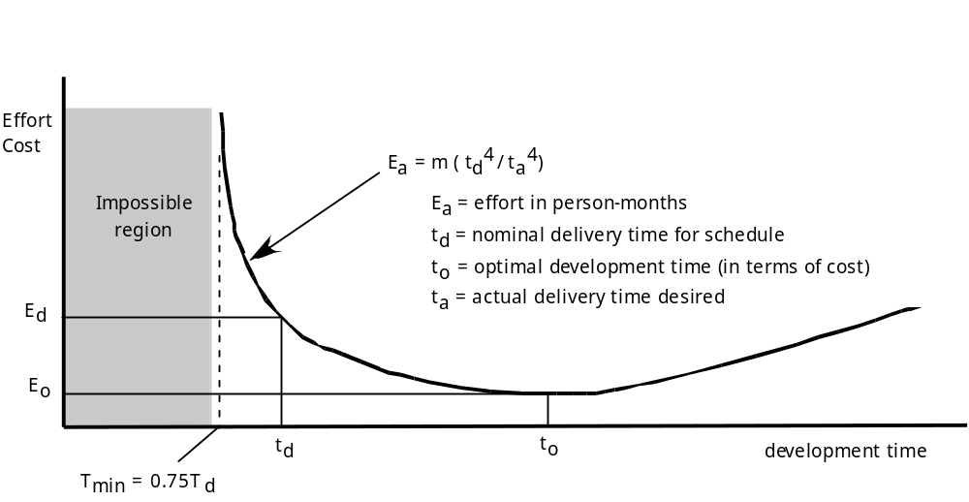
Effort and Delivery Time
California State University, cs437, Fall 2007

Slide 72
Effort Allocation
“front end” activities
  customer communication
  analysis
  design
  review and modification
construction activities
  coding or code generation
testing and installation
  unit, integration
  white-box, black box
  regression
40-50%
15-20%
30-40%
California State University, cs437, Fall 2007

Slide 73
Defining Task Sets
determine type of project
assess the degree of rigor required
identify adaptation criteria
select appropriate software engineering tasks
California State University, cs437, Fall 2007

Slide 74
Task Set Refinement
1.1 Concept scoping determines the overall scope of the project.
Task definition: Task 1.1 Concept Scoping
1.1.1 Identify need, benefits and potential customers;
1.1.2 Define desired output/control and input events that drive the application;
Begin Task 1.1.2
1.1.2.1 FTR: Review written description of need
  FTR indicates that a formal technical review (Chapter 26) is to be conducted.
1.1.2.2 Derive a list of customer visible outputs/inputs
1.1.2.3 FTR: Review outputs/inputs with customer and revise as required;
endtask Task 1.1.2
1.1.3 Define the functionality/behavior for each major function;
Begin Task 1.1.3
1.1.3.1 FTR: Review output and input data objects derived in task 1.1.2;
1.1.3.2 Derive a model of functions/behaviors;
1.1.3.3 FTR: Review functions/behaviors with customer and revise as required;
endtask Task 1.1.3
1.1.4 Isolate those elements of the technology to be implemented in software;
1.1.5 Research availability of existing software;
1.1.6 Define technical feasibility;
1.1.7 Make quick estimate of size;
1.1.8 Create a Scope Definition;
endTask definition: Task 1.1
is refined to
California State University, cs437, Fall 2007

Slide 75
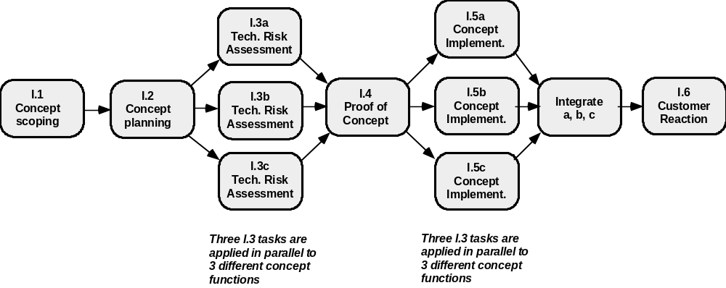
Define a Task Network
California State University, cs437, Fall 2007

Slide 76
Timeline Charts
Tasks
Week 1
Week 2
Week 3
Week 4
Week n
Task 1
Task 2
Task 3
Task 4
Task 5
Task 6
Task 7
Task 8
Task 9
Task 10
Task 11
Task 12
California State University, cs437, Fall 2007

Slide 77
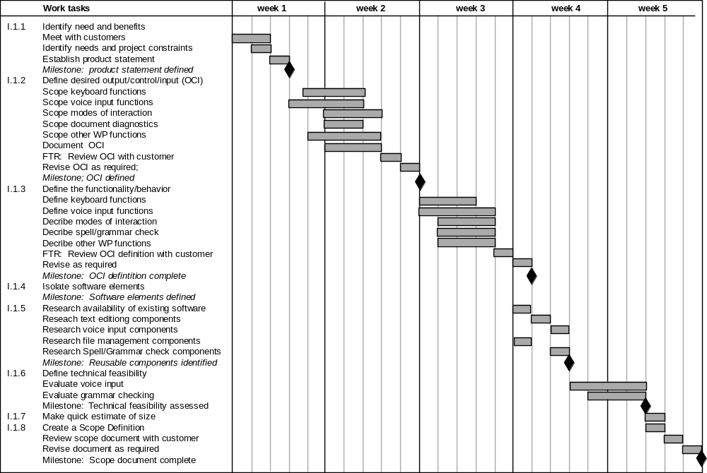
Use Automated Tools to
Derive a Timeline Chart
California State University, cs437, Fall 2007

Slide 78
Schedule Tracking
  conduct periodic project status meetings in which each team member reports progress and problems.
  evaluate the results of all reviews conducted throughout the software engineering process.
  determine whether formal project milestones (the diamonds shown in Figure 24.3) have been accomplished by the scheduled date.
  compare actual start-date to planned start-date for each project task listed in the resource table (Figure 24.4).
  meet informally with practitioners to obtain their subjective assessment of progress to date and problems on the horizon.
  use earned value analysis (Section 24.6) to assess progress quantitatively.
California State University, cs437, Fall 2007

Slide 79
Progress on an OO Project-I
Technical milestone: OO analysis completed
    All classes and the class hierarchy have been defined and reviewed.
    Class attributes and operations associated with a class have been defined and reviewed.
    Class relationships (Chapter 8) have been established and reviewed.
    A behavioral model (Chapter 8) has been created and reviewed.
    Reusable classes have been noted.
Technical milestone: OO design completed
    The set of subsystems (Chapter 9) has been defined and reviewed.
    Classes are allocated to subsystems and reviewed.
    Task allocation has been established and reviewed.
    Responsibilities and collaborations (Chapter 9) have been identified.
    Attributes and operations have been designed and reviewed.
    The communication model has been created and reviewed.
California State University, cs437, Fall 2007

Slide 80
Progress on an OO Project-II
Technical milestone: OO programming completed
    Each new class has been implemented in code from the design model.
    Extracted classes (from a reuse library) have been implemented.
    Prototype or increment has been built.
Technical milestone: OO testing
    The correctness and completeness of OO analysis and design models has been reviewed.
    A class-responsibility-collaboration network (Chapter 8) has been developed and reviewed.
    Test cases are designed and class-level tests (Chapter 14) have been conducted for each class.
    Test cases are designed and cluster testing (Chapter 14) is completed and the classes are integrated.
    System level tests have been completed.
California State University, cs437, Fall 2007

Slide 81
Earned Value Analysis (EVA)
Earned value
  is a measure of progress
  enables us to assess the “percent of completeness” of a project using quantitative analysis rather than rely on a gut feeling
  “provides accurate and reliable readings of performance from as early as 15 percent into the project.” [FLE98]
California State University, cs437, Fall 2007

Slide 82
Computing Earned Value-I
The budgeted cost of work scheduled (BCWS) is determined for each work task represented in the schedule.
  BCWS_{i} is the effort planned for work task i.
  To determine progress at a given point along the project schedule, the value of BCWS is the sum of the BCWS_{i} values for all work tasks that should have been completed by that point in time on the project schedule.
The BCWS values for all work tasks are summed to derive the budget at completion, BAC. Hence,
BAC = ∑ (BCWS_{k}) for all tasks k
California State University, cs437, Fall 2007

Slide 83
Computing Earned Value-II
Next, the value for budgeted cost of work performed (BCWP) is computed.
  The value for BCWP is the sum of the BCWS values for all work tasks that have actually been completed by a point in time on the project schedule.
“the distinction between the BCWS and the BCWP is that the former represents the budget of the activities that were planned to be completed and the latter represents the budget of the activities that actually were completed.” [WIL99]
Given values for BCWS, BAC, and BCWP, important progress indicators can be computed:
    Schedule performance index, SPI = BCWP/BCWS
    Schedule variance, SV = BCWP – BCWS
    SPI is an indication of the efficiency with which the project is utilizing scheduled resources.
California State University, cs437, Fall 2007

Slide 84
Computing Earned Value-III
Percent scheduled for completion = BCWS/BAC
  provides an indication of the percentage of work that should have been completed by time t.
Percent complete = BCWP/BAC
  provides a quantitative indication of the percent of completeness of the project at a given point in time, t.
Actual cost of work performed, ACWP, is the sum of the effort actually expended on work tasks that have been completed by a point in time on the project schedule. It is then possible to compute
    Cost performance index, CPI = BCWP/ACWP
    Cost variance, CV = BCWP – ACWP
California State University, cs437, Fall 2007

Slide 85
Chapter 25
Risk Management
California State University, cs437, Fall 2007

Slide 86
Project Risks
What can go wrong?
What is the likelihood?
What will the damage be?
What can we do about it?
California State University, cs437, Fall 2007

Slide 87
Reactive Risk Management
  project team reacts to risks when they occur
  mitigation—plan for additional resources in anticipation of fire fighting
  fix on failure—resource are found and applied when the risk strikes
  crisis management—failure does not respond to applied resources and project is in jeopardy
California State University, cs437, Fall 2007

Slide 88
Proactive Risk Management
formal risk analysis is performed
organization corrects the root causes of risk
  TQM concepts and statistical SQA
  examining risk sources that lie beyond the bounds of the software
  developing the skill to manage change
California State University, cs437, Fall 2007
TQM = Total Quality Management

Slide 89
Seven Principles
Maintain a global perspective—view software risks within the context of system and the business problem
Take a forward-looking view—think about the risks that may arise in the future; establish contingency plans
Encourage open communication—if someone states a potential risk, don’t discount it.
Integrate—a consideration of risk must be integrated into the software process
Emphasize a continuous process—the team must be vigilant throughout the software process, modifying identified risks as more information is known and adding new ones as better insight is achieved.
Develop a shared product vision—if all stakeholders share the same vision of the software, it likely that better risk identification and assessment will occur.
Encourage teamwork—the talents, skills and knowledge of all stakeholder should be pooled
California State University, cs437, Fall 2007

Slide 90
Risk Management Paradigm
control
track
RISK
identify
plan
analyze
California State University, cs437, Fall 2007

Slide 91
Risk Identification
Product size—risks associated with the overall size of the software to be built or modified.
Business impact—risks associated with constraints imposed by management or the marketplace.
Customer characteristics—risks associated with the sophistication of the customer and the developer's ability to communicate with the customer in a timely manner.
Process definition—risks associated with the degree to which the software process has been defined and is followed by the development organization.
Development environment—risks associated with the availability and quality of the tools to be used to build the product.
Technology to be built—risks associated with the complexity of the system to be built and the "newness" of the technology that is packaged by the system.
Staff size and experience—risks associated with the overall technical and project experience of the software engineers who will do the work.
California State University, cs437, Fall 2007

Slide 92
Assessing Project Risk-I
Have top software and customer managers formally committed to support the project?
Are end-users enthusiastically committed to the project and the system/product to be built?
Are requirements fully understood by the software engineering team and their customers?
Have customers been involved fully in the definition of requirements?
Do end-users have realistic expectations?
California State University, cs437, Fall 2007

Slide 93
Assessing Project Risk-II
Is project scope stable?
Does the software engineering team have the right mix of skills?
Are project requirements stable?
Does the project team have experience with the technology to be implemented?
Is the number of people on the project team adequate to do the job?
Do all customer/user constituencies agree on the importance of the project and on the requirements for the system/product to be built?
California State University, cs437, Fall 2007

Slide 94
Risk Components
performance risk—the degree of uncertainty that the product will meet its requirements and be fit for its intended use.
cost risk—the degree of uncertainty that the project budget will be maintained.
support risk—the degree of uncertainty that the resultant software will be easy to correct, adapt, and enhance.
schedule risk—the degree of uncertainty that the project schedule will be maintained and that the product will be delivered on time.
California State University, cs437, Fall 2007

Slide 95
Risk Projection
Risk projection, also called risk estimation, attempts to rate each risk in two ways
  the likelihood or probability that the risk is real
  the consequences of the problems associated with the risk, should it occur.
The are four risk projection steps:
    establish a scale that reflects the perceived likelihood of a risk
    delineate the consequences of the risk
    estimate the impact of the risk on the project and the product,
    note the overall accuracy of the risk projection so that there will be no misunderstandings.
California State University, cs437, Fall 2007

Slide 96
Building a Risk Table
Risk
Probability
Impact
RMMM
Risk
Mitigation
Monitoring
&
Management
California State University, cs437, Fall 2007

Slide 97
Building the Risk Table
Estimate the probability of occurrence
Estimate the impact on the project on a scale of 1 to 5, where
  1 = low impact on project success
  5 = catastrophic impact on project success
sort the table by probability and impact
California State University, cs437, Fall 2007

Slide 98
Risk Exposure (Impact)
The overall risk exposure, RE, is determined using the following relationship [HAL98]:
RE = P x C
where
P is the probability of occurrence for a risk, and
C is the cost to the project should the risk occur.
California State University, cs437, Fall 2007

Slide 99
Risk Exposure Example
Risk identification. Only 70 percent of the software components scheduled for reuse will, in fact, be integrated into the application. The remaining functionality will have to be custom developed.
Risk probability. 80% (likely).
Risk impact. 60 reusable software components were planned. If only 70 percent can be used, 18 components would have to be developed from scratch (in addition to other custom software that has been scheduled for development). Since the average component is 1000 LOC and local data indicate that the software engineering cost for each LOC is $14.00, the overall cost (impact) to develop the components would be 18 x 1000 x 14 = $252,000.
Risk exposure. RE = 0.80 x 252,000 ~ $202,000.
California State University, cs437, Fall 2007

Slide 100
Risk Mitigation, Monitoring, and Management
mitigation—how can we avoid the risk?
monitoring—what factors can we track that will enable us to determine if the risk is becoming more or less likely?
management—what contingency plans do we have if the risk becomes a reality?
California State University, cs437, Fall 2007

Slide 101
Risk Due to Product Size
Attributes that affect risk:
• estimated size of the product in LOC or FP?
• estimated size of product in number of programs,
files, transactions?
• percentage deviation in size of product from
average for previous products?
• size of database created or used by the product?
• number of users of the product?
• number of projected changes to the requirements
for the product? before delivery? after delivery?
• amount of reused software?
California State University, cs437, Fall 2007

Slide 102
Risk Due to Business Impact
Attributes that affect risk:
• affect of this product on company revenue?
• visibility of this product by senior management?
• reasonableness of delivery deadline?
• number of customers who will use this product
• interoperability constraints
• sophistication of end users?
• amount and quality of product documentation that
must be produced and delivered to the customer?
• governmental constraints
• costs associated with late delivery?
• costs associated with a defective product?
California State University, cs437, Fall 2007

Slide 103
Risks Due to the Customer
Questions that must be answered:
• Have you worked with the customer in the past?
• Does the customer have a solid idea of requirements?
• Has the customer agreed to spend time with you?
• Is the customer willing to participate in reviews?
• Is the customer technically sophisticated?
• Is the customer willing to let your people do their
job—that is, will the customer resist looking over your
shoulder during technically detailed work?
• Does the customer understand the software
engineering process?
California State University, cs437, Fall 2007

Slide 104
Risks Due to Process Maturity
Questions that must be answered:
• Have you established a common process framework?
• Is it followed by project teams?
• Do you have management support for software engineering
• Do you have a proactive approach to SQA?
• Do you conduct formal technical reviews?
• Are CASE tools used for analysis, design and
testing?
• Are the tools integrated with one another?
• Have document formats been established?
California State University, cs437, Fall 2007

Slide 105
Technology Risks
Questions that must be answered:
• Is the technology new to your organization?
• Are new algorithms, I/O technology required?
• Is new or unproven hardware involved?
• Does the application interface with new software?
• Is a specialized user interface required?
• Is the application radically different?
• Are you using new software engineering methods?
• Are you using unconventional software development
methods, such as formal methods, AI-based approaches,
artificial neural networks?
• Are there significant performance constraints?
• Is there doubt the functionality requested is "do-able?"
California State University, cs437, Fall 2007

Slide 106
Staff/People Risks
Questions that must be answered:
• Are the best people available?
• Does staff have the right skills?
• Are enough people available?
• Are staff committed for entire duration?
• Will some people work part time?
• Do staff have the right expectations?
• Have staff received necessary training?
• Will turnover among staff be low?
California State University, cs437, Fall 2007

Slide 107
Recording Risk Information
Project: Embedded software for XYZ system
Risk type: schedule risk
Priority (1 low ... 5 critical): 4
Risk factor: Project completion will depend on tests which require
hardware component under development. Hardware component
delivery may be delayed
Probability: 60 %
Impact: Project completion will be delayed for each day that
hardware is unavailable for use in software testing
Monitoring approach:
Scheduled milestone reviews with hardware group
Contingency plan:
Modification of testing strategy to accommodate delay using
software simulation
Estimated resources: 6 additional person months beginning 7-1-96
California State University, cs437, Fall 2007

Slide 108
Chapter 26
Quality Management
California State University, cs437, Fall 2007

Slide 109
Quality
The American Heritage Dictionary defines quality as
  “a characteristic or attribute of something.”
For software, two kinds of quality may be encountered:
  Quality of design encompasses requirements, specifications, and the design of the system.
  Quality of conformance is an issue focused primarily on implementation.
  user satisfaction = compliant product + good quality + delivery within budget and schedule
California State University, cs437, Fall 2007

Slide 110
Software Quality
Conformance to explicitly stated functional and performance requirements, explicitly documented development standards, and implicit characteristics that are expected of all professionally developed software.
California State University, cs437, Fall 2007

Slide 111
Cost of Quality
Prevention costs include
  quality planning
  formal technical reviews
  test equipment
  Training
Internal failure costs include
  rework
  repair
  failure mode analysis
External failure costs are
  complaint resolution
  product return and replacement
  help line support
  warranty work
California State University, cs437, Fall 2007

Slide 112
Software Quality Assurance
Process
Definition &
Standards
Formal
Technical
Reviews
Analysis
&
Reporting
Test
Planning
& Review
Measurement
California State University, cs437, Fall 2007

Slide 113
Role of the SQA Group-I
Prepares an SQA plan for a project.
  The plan identifies
    evaluations to be performed
    audits and reviews to be performed
    standards that are applicable to the project
    procedures for error reporting and tracking
    documents to be produced by the SQA group
    amount of feedback provided to the software project team
Participates in the development of the project’s software process description.
  The SQA group reviews the process description for compliance with organizational policy, internal software standards, externally imposed standards (e.g., ISO-9001), and other parts of the software project plan.
California State University, cs437, Fall 2007

Slide 114
Role of the SQA Group-II
Reviews software engineering activities to verify compliance with the defined software process.
  identifies, documents, and tracks deviations from the process and verifies that corrections have been made.
Audits designated software work products to verify compliance with those defined as part of the software process.
  reviews selected work products; identifies, documents, and tracks deviations; verifies that corrections have been made
  periodically reports the results of its work to the project manager.
Ensures that deviations in software work and work products are documented and handled according to a documented procedure.
Records any noncompliance and reports to senior management.
  Noncompliance items are tracked until they are resolved.
California State University, cs437, Fall 2007

Slide 115
Why SQA Activities Pay Off?
cost to find
and fix a defect
100
60.00-100.00
log
scale
10
10.00
3.00
1.50
1.00
1
0.75
Design
test
field
Req.
system
use
code
test
California State University, cs437, Fall 2007

Slide 116
Reviews & Inspections
... there is no particular reason
why your friend and colleague
cannot also be your sternest critic.
Jerry Weinberg
California State University, cs437, Fall 2007

Slide 117
What Are Reviews?
a meeting conducted by technical people for technical people
a technical assessment of a work product created during the software engineering process
a software quality assurance mechanism
a training ground
California State University, cs437, Fall 2007

Slide 118
What Reviews Are Not
A project summary or progress assessment
A meeting intended solely to impart information
A mechanism for political or personal reprisal!
California State University, cs437, Fall 2007

Slide 119
The Players
review
leader
standards bearer (SQA)
producer
maintenance
oracle
recorder
reviewer
user rep
California State University, cs437, Fall 2007

Slide 120
Conducting the Review
1.
be prepared—evaluate
product before the review
2.
review the product, not
the producer
3.
keep your tone mild, ask
questions instead of
making accusations
4.
stick to the review agenda
5.
raise issues, don't resolve them
6.
avoid discussions of style—stick to technical
correctness
7.
schedule reviews as project tasks
8.
record and report all review results
California State University, cs437, Fall 2007

Slide 121
Review Options Matrix
*
IPR
WT
IN
RRR
trained leader
agenda established
reviewers prepare in advance
producer presents product
“reader” presents product
recorder takes notes
checklists used to find errors
errors categorized as found
issues list created
team must sign-off on result
IPR—informal peer review WT—Walkthrough
IN—Inspection RRR—round robin review
yes
yes
yes
no
yes
yes
yes
yes
yes
yes
yes
yes
yes
no
no
yes
no
no
yes
maybe
no
maybe
maybe
maybe
no
maybe
no
no
no
no
yes
yes
yes
yes
no
yes
no
no
yes
yes
*
California State University, cs437, Fall 2007

Slide 122
Sample-Driven Reviews (SDRs)
SDRs attempt to quantify those work products that are primary targets for full FTRs (Formal Technical Reviews).
To accomplish this …
Inspect a fraction a_{i} of each software work product, i. Record the number of faults, f_{i} found within a_{i}.
Develop a gross estimate of the number of faults within work product i by multiplying f_{i} by 1/a_{i}.
Sort the work products in descending order according to the gross estimate of the number of faults in each.
Focus available review resources on those work products that have the highest estimated number of faults.
California State University, cs437, Fall 2007

Slide 123
Metrics Derived from Reviews
inspection time per page of documentation
inspection time per KLOC or FP
inspection effort per KLOC or FP
errors uncovered per reviewer hour
errors uncovered per preparation hour
errors uncovered per SE task (e.g., design)
number of minor errors (e.g., typos)
number of major errors
(e.g., nonconformance to req.)
number of errors found during preparation
California State University, cs437, Fall 2007

Slide 124
Statistical SQA
Product
& Process
Collect information on all defects
Find the causes of the defects
Move to provide fixes for the process
measurement
... an understanding of how
to improve quality ...
California State University, cs437, Fall 2007

Slide 125
Statistical SQA: An Example
Defect Acronym | Defect Name
IES | Incomplete or erroneous specifications
MCC | Misinterpretation of customer communication
IDP | Intentional deviation from specification
VPS | Violation of programming standards
EDR | Error in data representation
ICI | Inconsistent component interface
EDL | Error in design logic
IET | Incomplete or erroneous testing
IID | Inaccurate or incomplete documentation
PLT | Error in programming language translation or design
HCI | Ambiguous or inconsistent human/computer interface
MIS | Miscellaneous
California State University, cs437, Fall 2007

Slide 126
Statistical SQA: An Example
Total Serious Moderate Minor
Error | No. | % | No. | % | No. | % | No. | %
IES | 205 | 22 | 34 | 27 | 68 | 18 | 103 | 24
MCC | 156 | 17 | 12 | 9 | 68 | 18 | 76 | 17
IDP | 48 | 5 | 1 | 1 | 24 | 6 | 23 | 5
VPS | 25 | 3 | 0 | 0 | 15 | 4 | 10 | 2
EDR | 130 | 14 | 26 | 20 | 68 | 18 | 36 | 8
ICI | 58 | 6 | 9 | 7 | 18 | 5 | 31 | 7
EDL | 45 | 5 | 14 | 11 | 12 | 3 | 19 | 4
IET | 95 | 10 | 12 | 9 | 35 | 9 | 48 | 11
IID | 36 | 4 | 2 | 2 | 20 | 5 | 14 | 3
PLT | 60 | 6 | 15 | 12 | 19 | 5 | 26 | 6
HCI | 28 | 3 | 3 | 2 | 17 | 4 | 8 | 2
MIS | 56 | 6 | 0 | 0 | 15 | 4 | 41 | 9
Totals | 942 | 100% | 128 | 100% | 379 | 100% | 435 | 100%
California State University, cs437, Fall 2007

Slide 127
Six-Sigma for Software Engineering
The term “six sigma” is derived from six standard deviations—3.4 instances (defects) per million occurrences—implying an extremely high quality standard.
The Six Sigma methodology defines three core steps:
  Define customer requirements and deliverables and project goals via well-defined methods of customer communication
  Measure the existing process and its output to determine current quality performance (collect defect metrics)
  Analyze defect metrics and determine the vital few causes.
If an existing SW is in place, but improvement is required , Six Sigma suggests two additional steps:
  Improve the process by eliminating the root causes of defects.
  Control the process to ensure that future work does not reintroduce the causes of defects.
California State University, cs437, Fall 2007

Slide 128
Software Reliability and Availability
A simple measure of reliability is mean-time-between-failure (MTBF), where
MTBF = MTTF + MTTR
The acronyms MTTF and MTTR are mean-time-to-failure and mean-time-to-repair, respectively.
Software availability is the probability that a program is operating according to requirements at a given point in time and is defined as
Availability = [MTTF/(MTTF + MTTR)] x 100%
California State University, cs437, Fall 2007

Slide 129
Software Safety
E.I. Smith, captain of the Titanic: “I cannot imagine any condition which would cause this ship to founder. Modern shipbuilding has gone beyond that”.
Software safety is a software quality assurance activity that focuses on the identification and assessment of potential hazards that may affect software negatively and cause an entire system to fail.
If hazards can be identified early in the software process, software design features can be specified that will either eliminate or control potential hazards.
California State University, cs437, Fall 2007

Slide 130
Mistake-Proofing
Poka-yoke (mistake-proofing or fail-safing) devices—mechanisms that lead to
  the prevention of a potential quality problem before it occurs or
  the rapid detection of quality problems if they are introduced.
An effective poka-yoke device exhibits a set of common characteristics:
  It is simple and cheap. If a device is too complicated or expensive, it will not be cost effective.
  It is part of the process. That is, the poka-yoke device is integrated into an engineering activity.
  It is located near the process task where the mistakes occur. Thus, it provides rapid feedback and error correction.
From the Japanese (at Toyota): avoiding - yokeru; inadvertent errors - yoka
California State University, cs437, Fall 2007

Slide 131
ISO 9001:2000 Standard
ISO 9001:2000 is the quality assurance standard that applies to software engineering.
The standard contains 20 requirements that must be present for an effective quality assurance system.
The requirements delineated by ISO 9001:2000 address topics such as
  management responsibility, quality system, contract review, design control, document and data control, product identification and traceability, process control, inspection and testing, corrective and preventive action, control of quality records, internal quality audits, training, servicing, and statistical techniques.
California State University, cs437, Fall 2007

Slide 132
Chapter 27
Change Management
California State University, cs437, Fall 2007

Slide 133
The “First Law”
No matter where you are in the system life cycle, the system will change, and the desire to change it will persist throughout the life cycle.
Bersoff, et al, 1980
California State University, cs437, Fall 2007

Slide 134
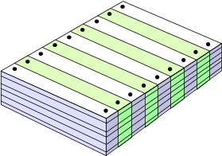
What Are These Changes?
changes in
business requirements
changes in
technical requirements
changes in
user requirements
other
documents
software models
Project
Plan
data
Test
code
California State University, cs437, Fall 2007

Slide 135
The Software Configuration
programs
documents
The pieces
data
California State University, cs437, Fall 2007

Slide 136
Baselines
The IEEE (IEEE Std. No. 610.12-1990) defines a baseline as:
    A specification or product that has been formally reviewed and agreed upon, that thereafter serves as the basis for further development, and that can be changed only through formal change control procedures.
a baseline is a milestone in the development of software that is marked by the delivery of one or more Software Configuration Items, SCIs, and the approval of these SCIs that is obtained through a formal technical review
California State University, cs437, Fall 2007

Slide 137
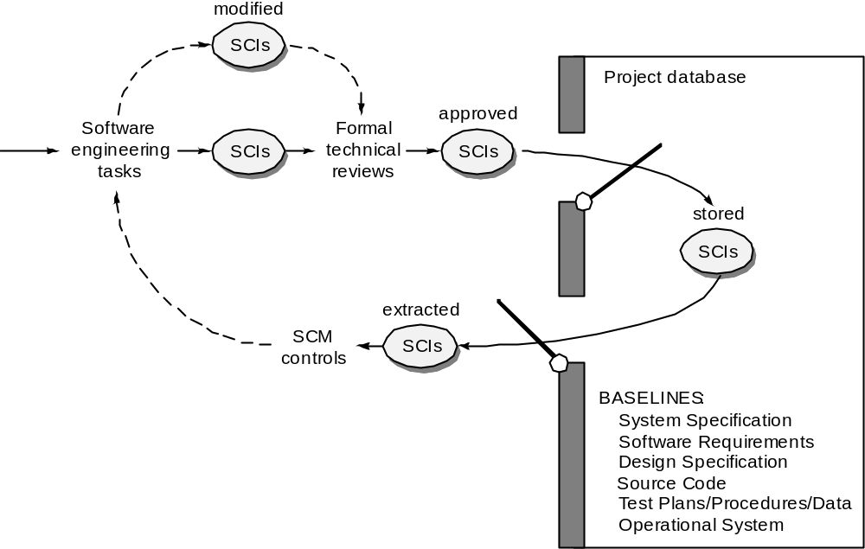
Baselines
California State University, cs437, Fall 2007

Slide 138
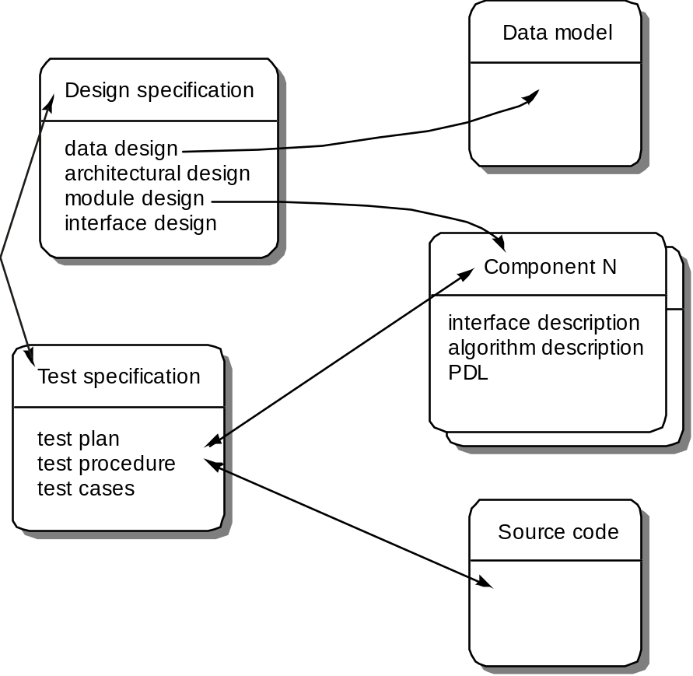
Software Configuration Objects
California State University, cs437, Fall 2007

Slide 139
SCM Repository
The SCM repository is the set of mechanisms and data structures that allow a software team to manage change in an effective manner
The repository performs or precipitates the following functions [FOR89]:
  Data integrity
  Information sharing
  Tool integration
  Data integration
  Methodology enforcement
  Document standardization
California State University, cs437, Fall 2007

Slide 140
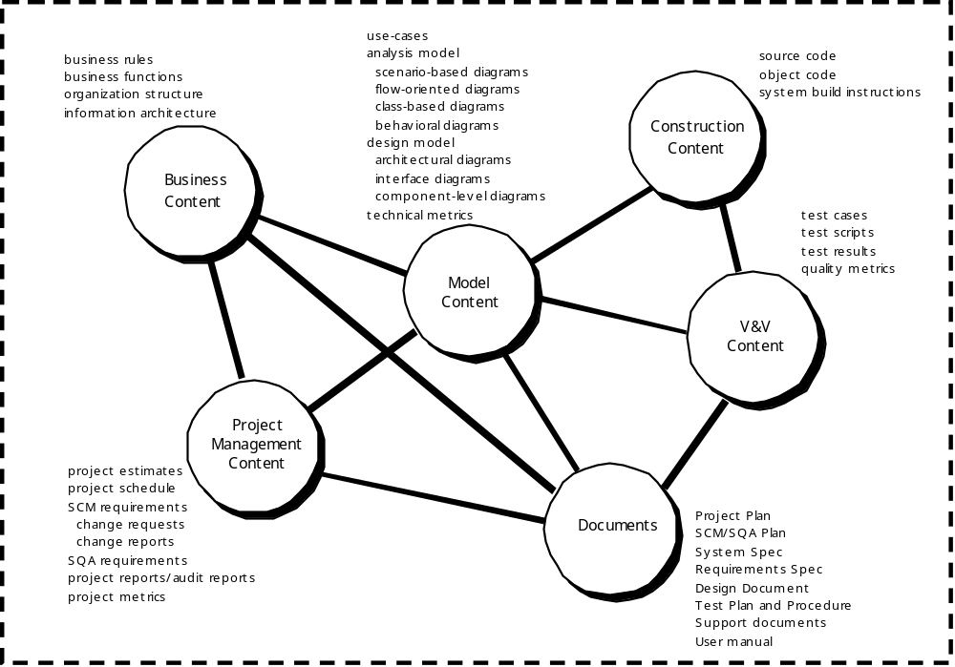
Repository Content
California State University, cs437, Fall 2007

Slide 141
Repository Features
Versioning.
  saves all of these versions to enable effective management of product releases and to permit developers to go back to previous versions.
Dependency tracking and change management.
  The repository manages a wide variety of relationships among the data elements stored in it.
Requirements tracing.
  Provides the ability to track all the design and construction components and deliverables that result from a specific requirement specification.
Configuration management.
  Keeps track of a series of configurations representing specific project milestones or production releases. Version management provides the needed versions, and link management keeps track of interdependencies.
Audit trails.
  establishes additional information about when, why, and by whom changes are made.
California State University, cs437, Fall 2007

Slide 142
SCM Elements
Component elements—a set of tools coupled within a file management system (e.g., a database) that enables access to and management of each software configuration item.
Process elements—a collection of procedures and tasks that define an effective approach to change management (and related activities) for all constituencies involved in the management, engineering and use of computer software.
Construction elements—a set of tools that automate the construction of software by ensuring that the proper set of validated components (i.e., the correct version) have been assembled.
Human elements—to implement effective SCM, the software team uses a set of tools and process features (encompassing other CM elements)
California State University, cs437, Fall 2007

Slide 143
The SCM Process
Addresses the following questions …
How does a software team identify the discrete elements of a software configuration?
How does an organization manage the many existing versions of a program (and its documentation) in a manner that will enable change to be accommodated efficiently?
How does an organization control changes before and after software is released to a customer?
Who has responsibility for approving and ranking changes?
How can we ensure that changes have been made properly?
What mechanism is used to appraise others of changes that are made?
California State University, cs437, Fall 2007

Slide 144

The SCM Process
California State University, cs437, Fall 2007

Slide 145
Version Control
Version control combines procedures and tools to manage different versions of configuration objects that are created during the software process
A version control system implements or is directly integrated with four major capabilities:
  a project database (repository) that stores all relevant configuration objects
  a version management capability that stores all versions of a configuration object (or enables any version to be constructed using differences from past versions);
  a make facility that enables the software engineer to collect all relevant configuration objects and construct a specific version of the software.
  an issues tracking (also called bug tracking) capability that enables the team to record and track the status of all outstanding issues associated with each configuration object.
California State University, cs437, Fall 2007

Slide 146
Change Control
STOP
California State University, cs437, Fall 2007

Slide 147
Change Control Process—I
need for change is recognized
change request from user
developer evaluates
change report is generated
change control authority decides
request is queued for action
change request is denied
user is informed
change control process—II
California State University, cs437, Fall 2007

Slide 148
Change Control Process-II
assign people to SCIs
check-out SCIs
make the change
review/audit the change
establish a “baseline” for testing
change control process—III
California State University, cs437, Fall 2007

Slide 149
Change Control Process-III
perform SQA and testing activities
check-in the changed SCIs
promote SCI for inclusion in next release
rebuild appropriate version
review/audit the change
include all changes in release
California State University, cs437, Fall 2007

Slide 150
Auditing
Change
Requests
SQA
Plan
SCIs
SCM Audit
California State University, cs437, Fall 2007

Slide 151
Status Accounting
Change
Reports
Change
Requests
ECOs
SCIs
Status Accounting
Reporting
California State University, cs437, Fall 2007

Slide 152
SCM for Web Engineering-I
Content.
  A typical WebApp contains a vast array of content—text, graphics, applets, scripts, audio/video files, forms, active page elements, tables, streaming data, and many others.
  The challenge is to organize this sea of content into a rational set of configuration objects (Section 27.1.4) and then establish appropriate configuration control mechanisms for these objects.
People.
  Because a significant percentage of WebApp development continues to be conducted in an ad hoc manner, any person involved in the WebApp can (and often does) create content.
California State University, cs437, Fall 2007

Slide 153
SCM for Web Engineering-II
Scalability.
  As size and complexity grow, small changes can have far-reaching and unintended affects that can be problematic. Therefore, the rigor of configuration control mechanisms should be directly proportional to application scale.
Politics.
  Who ‘owns’ a WebApp?
  Who assumes responsibility for the accuracy of the information on the Web site?
  Who assures that quality control processes have been followed before information is published to the site?
  Who is responsible for making changes?
  Who assumes the cost of change?
California State University, cs437, Fall 2007

Slide 154
Content Management-I
The collection subsystem encompasses all actions required to create and/or acquire content, and the technical functions that are necessary to
  convert content into a form that can be represented by a mark-up language (e.g., HTML, XML
  organize content into packets that can be displayed effectively on the client-side.
The management subsystem implements a repository that encompasses the following elements:
  Content database—the information structure that has been established to store all content objects
  Database capabilities—functions that enable the CMS to search for specific content objects (or categories of objects), store and retrieve objects, and manage the file structure that has been established for the content
  Configuration management functions—the functional elements and associated workflow that support content object identification, version control, change management, change auditing, and reporting.
California State University, cs437, Fall 2007

Slide 155
Content Management-II
The publishing subsystem extracts from the repository, converts it to a form that is amenable to publication, and formats it so that it can be transmitted to client-side browsers. The publishing subsystem accomplishes these tasks using a series of templates.
Each template is a function that builds a publication using one of three different components [BOI02]:
  Static elements—text, graphics, media, and scripts that require no further processing are transmitted directly to the client-side
  Publication services—function calls to specific retrieval and formatting services that personalize content (using predefined rules), perform data conversion, and build appropriate navigation links.
  External services—provide access to external corporate information infrastructure such as enterprise data or “back-room” applications.
California State University, cs437, Fall 2007

Slide 156
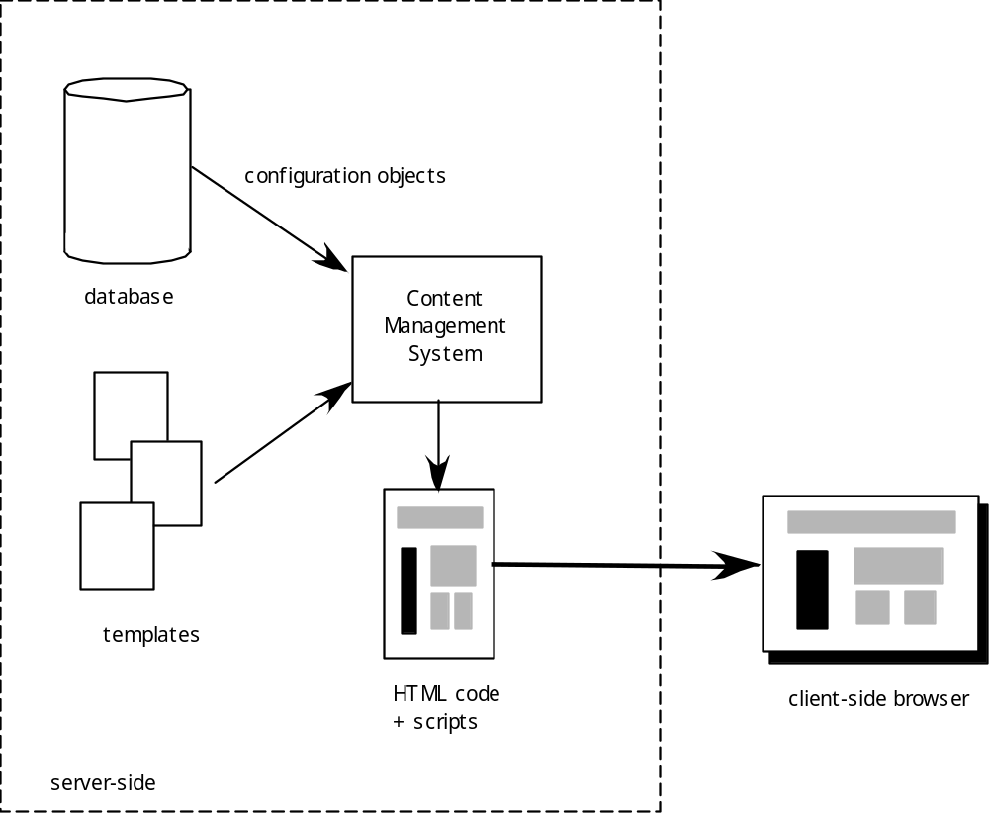
Content Management
California State University, cs437, Fall 2007

Slide 157
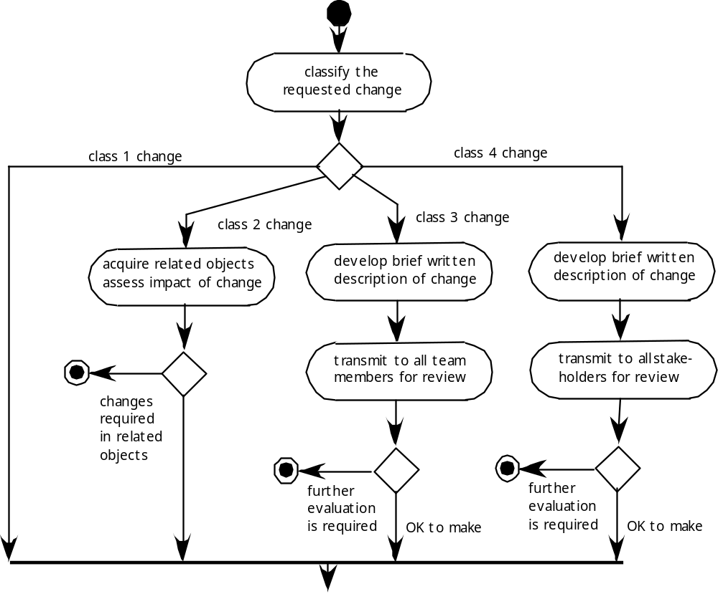
Change Management for WebApps-I
California State University, cs437, Fall 2007

Slide 158
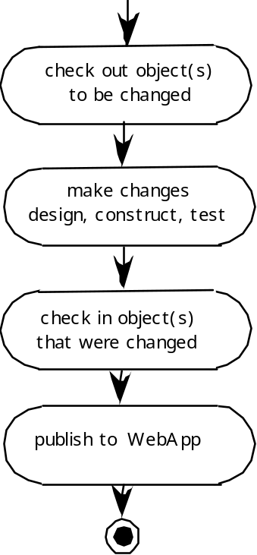
Change Management for WebApps-II
California State University, cs437, Fall 2007

